Slide 1
Pemrograman dart
materi 1 : Pengenalan & Installasi

Slide 2
m. Wahid alqorni
Instruktur synapse academy

Slide 3
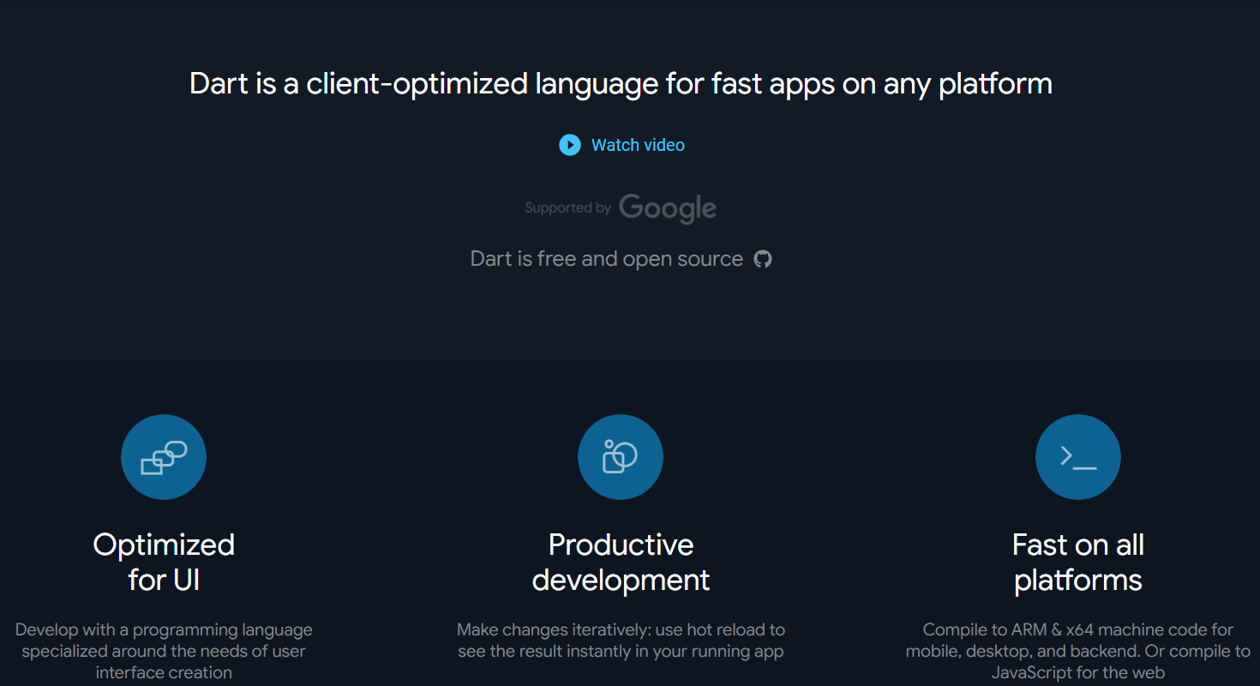
pengenalan
Source : https://dart.dev

Slide 4
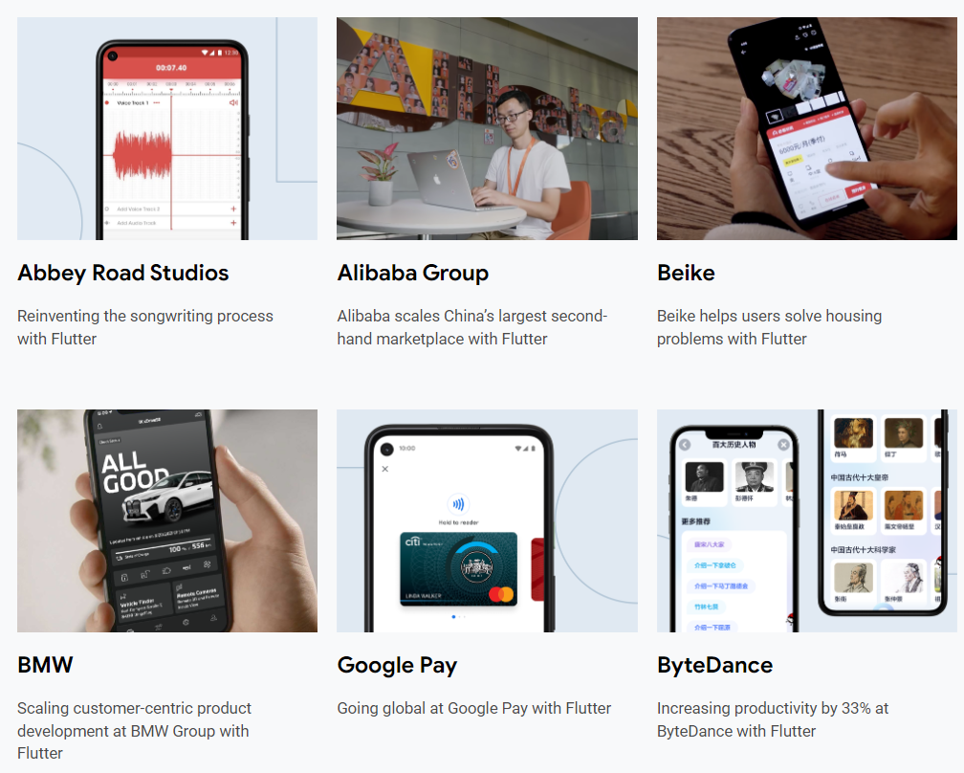
Apps made with Flutter
Source : https://flutter.dev/showcase

Slide 5
installasi
Link download software dart
https://bit.ly/3sX2kfF

Slide 6
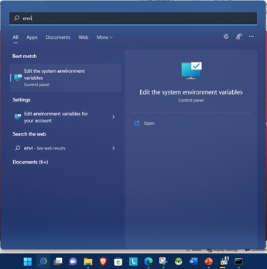
Installasi lanjutan..
Atur Environment Dart SDK
buka environtment dengan cara search di windows ‘environment’

Slide 7
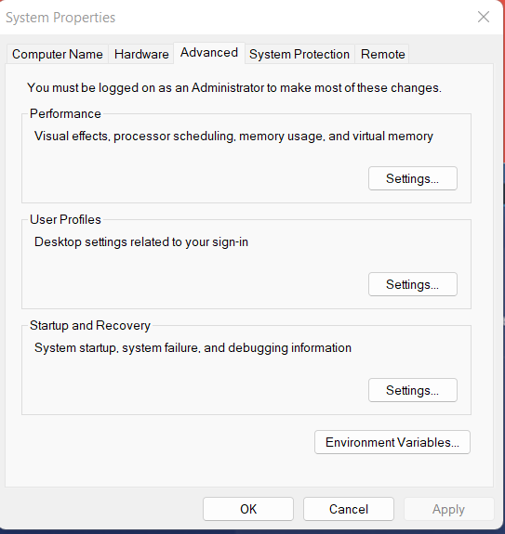
Installasi lanjutan..

Slide 8
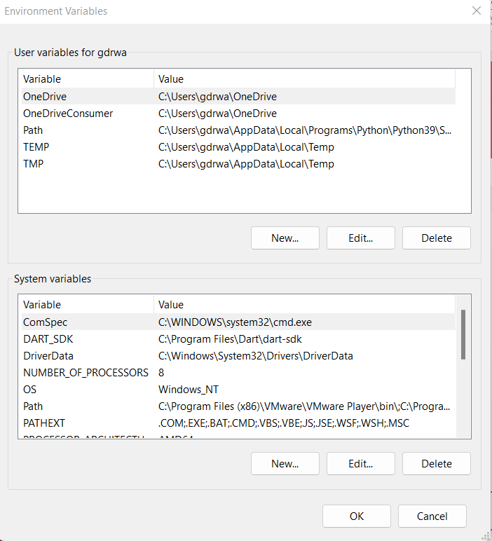
Installasi lanjutan..

Slide 9
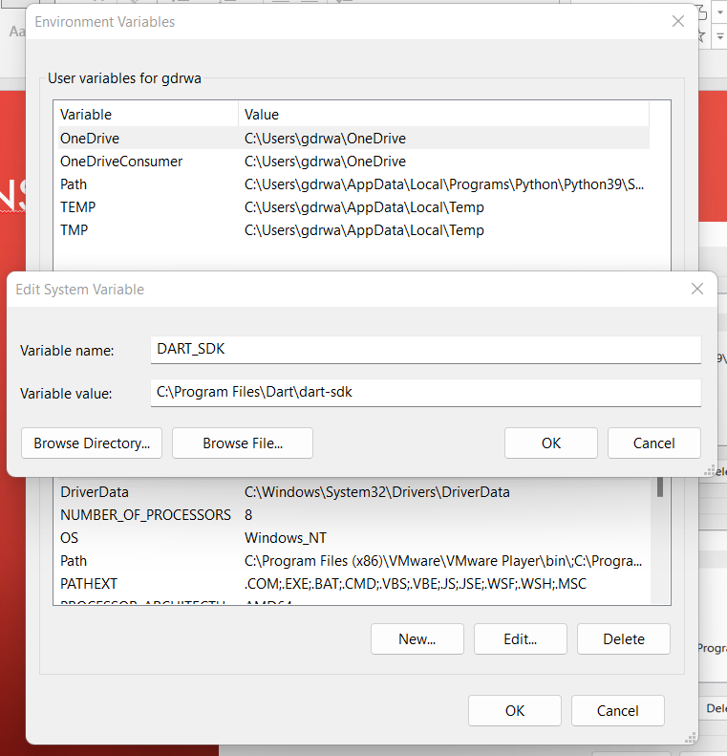
Installasi lanjutan..

Slide 10
Installasi lanjutan..
Install Visual Studio Code :
https://code.visualstudio.com/download

Slide 11
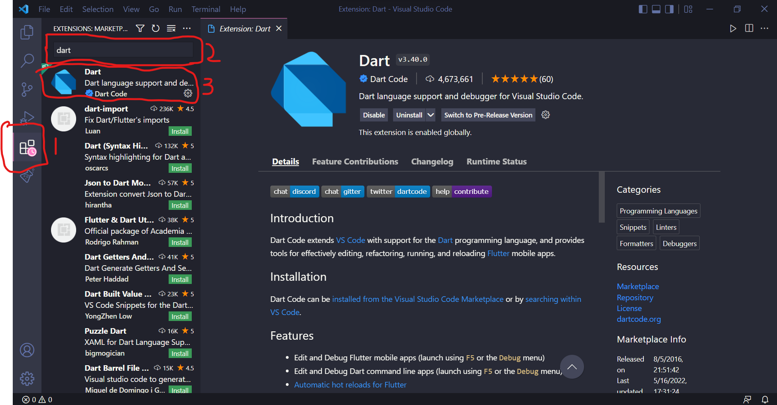
Installasi lanjutan..

Slide 12
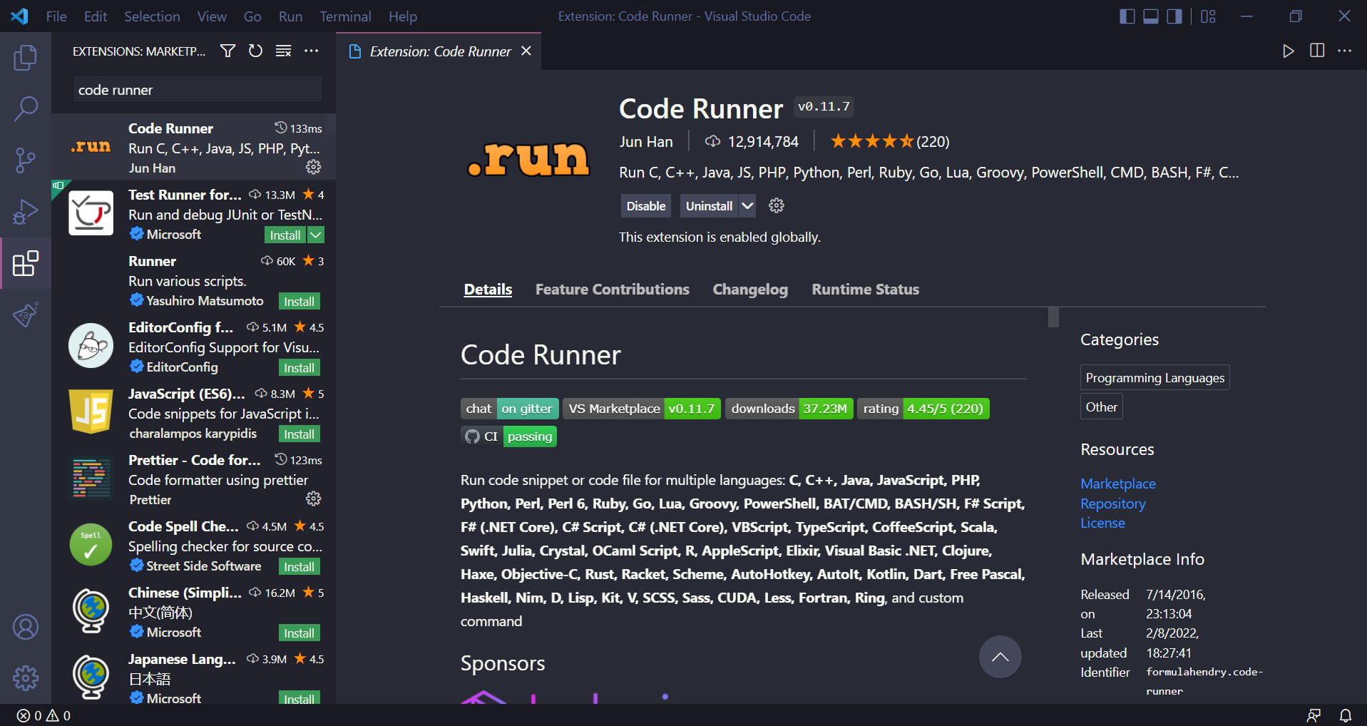
Installasi lanjutan..

